Slide 1

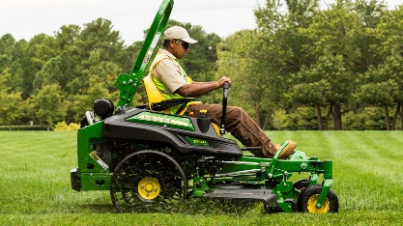
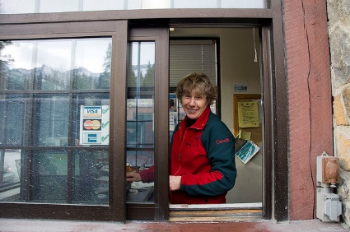
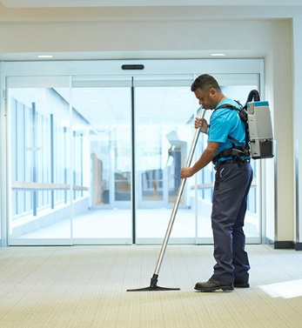

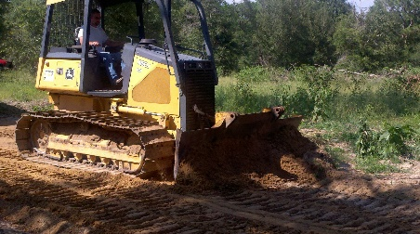


USACE BID ASSIST
HOW TO BID
USACE CONTACTS AND ADVERTISEMENTS BY LOCATION
SIGN UP FOR EMAIL NOTIFICATIONS
This site was developed by:
Welcome to the U.S. Army Corps of Engineers (USACE) bid assist website. We are here to guide you through the bidding process for all government contracts.
755,122 Views

Slide 2

HOW TO BID
STEP 1: THE DUNS AND BRADSTREET PROCESS
STEP 2: THE SAM.GOV PROCESS
STEP 3: THE FBO.GOV PROCESS
STEP 4: SUBMITTING YOUR COMPLETED PACKET
DISCLAIMER: Be aware that there is no charge for these services. Some companies may solicit and charge you to complete the registration process. The resources on this website will aid you in successfully bidding on a Government contract.

Slide 3
STEP 1: THE DUNS AND BRADSTREET PROCESS
*WEBSITE LINK: https://www.dnb.com/
There is no cost for obtaining your DUNS number. A DUNS number is a mandatory data element for registering in the database SAMS which is the next step after obtaining your DUNS number. This process will be explained on the SAMS.GOV process on step 2.
To begin, click on the above link to access the Duns and Bradstreet website. There is also the option to call 1-866-705-5711 for further assistance.
Once on the website, click on the tab that says “D-U-N-S NUMBER” on the top right of the page.
Scroll to the bottom of the webpage and select “Request a D-U-N-S Number for doing business with the Government”.
Then click on “Get a D-U-N-S Number” on the bottom left of the page.
Follow the step by step registration process. Remember the option to call 1-866-705-5711 for assistance.
Once completed, the DUNS number may be available instantaneously or it will be emailed or mailed to you within a few days. A good rule of thumb is 48 hours. Anything after this period of time follow up on your registration status through the DUNS website or by telephone.

Slide 4
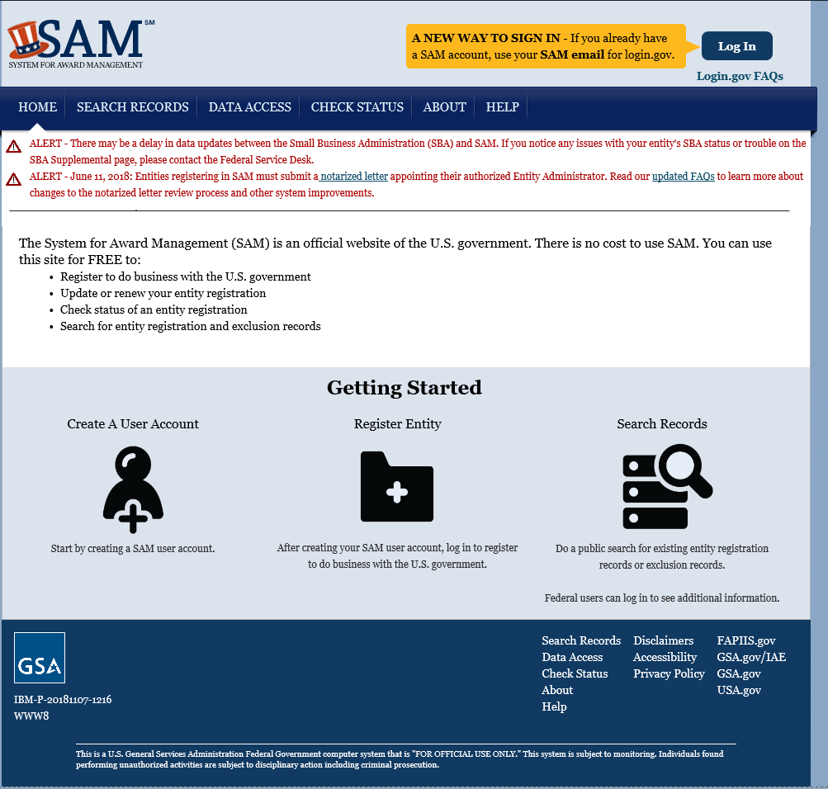
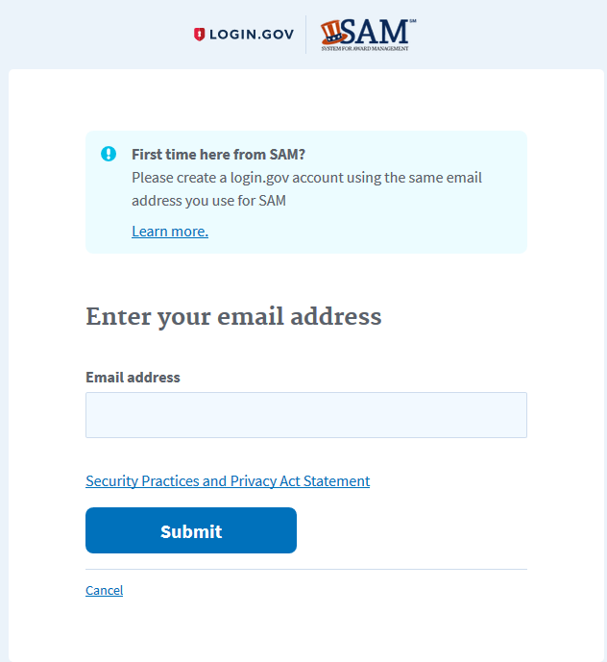
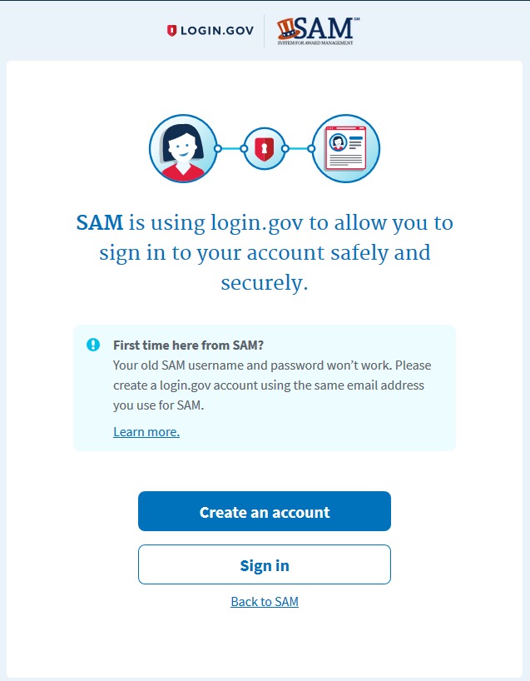
STEP 2: Setting Sam.gov Account
Click Link: https://www.sam.gov/SAM/pages/public/index.jsf
Login to www.Sam.gov
Click on login in the top right of the screen.
Click “create account”

Slide 5
STEP 2: Setting Sam.gov Account
To create your account at first you will need to fill out a form with basic information. Among the questions will be your name, country, phone, and an active email. (Click Next)
You will then be asked to create a Username and Password. As well as fill out 3 security questions with answers. These questions will help aid you in the future in case you lose your username or password. (Click Next)
You will then be sent to a summary page where you can review and edit the previous information. (Click Submit)
Immediately you will be sent an email from Sam.gov. Go to this email to click on the link it will prompt you to login. This will activate your account.
Once you login it will bring you to your “My Sam” page.
To start your registration click “Register New Entity” under Manage Entity.
To make the registration process faster have the following information ready. Duns #, Tax Payer Identification # (TIN), and all the correct information associated with the Duns #. For example your name and address must be the same on both Sam.gov and Duns and Bradstreet.
In order to be eligible to submit a bid all sections of the Sam.gov registration process must be filled out.
Be aware that you will need to renew your cage code and review your account information yearly.
Keep all logins and passwords for future use.
Special Note: When you update your address you must update in Dun & Bradstreet first and then Sam.gov. Also make sure both sites reflect the same name and information being used.
Helpful Tools:
The system will guide you through the process, follow all prompts. Below is a video tutorial that will guide you through the whole registration process. For more information or guidance refer to the USACE contacts page for individuals that will further aid you on this website.
Registering in Sam.gov:
https://www.youtube.com/watch?v=9VPGVYPvch4

Slide 6
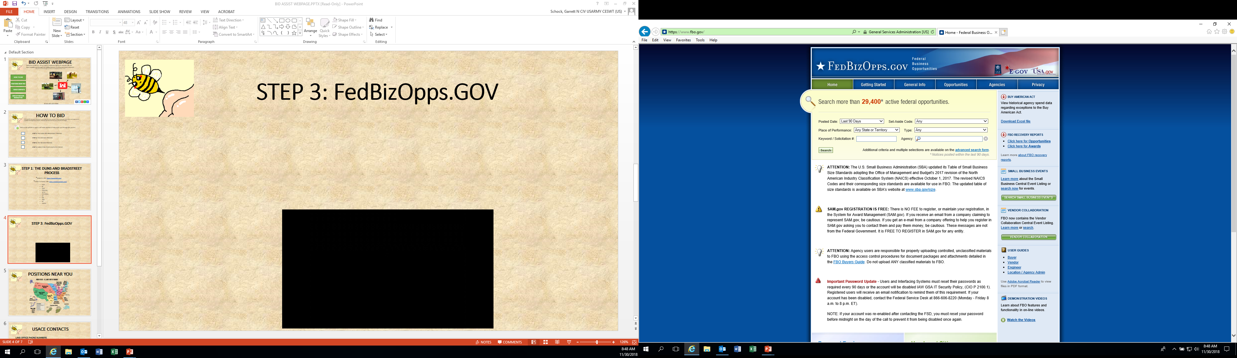
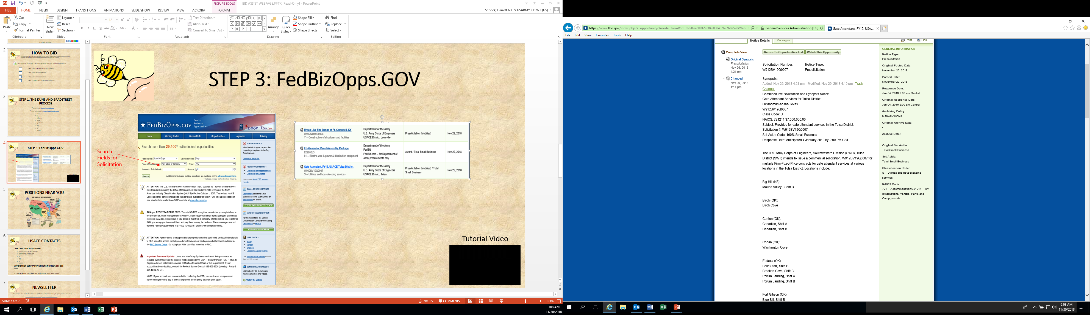
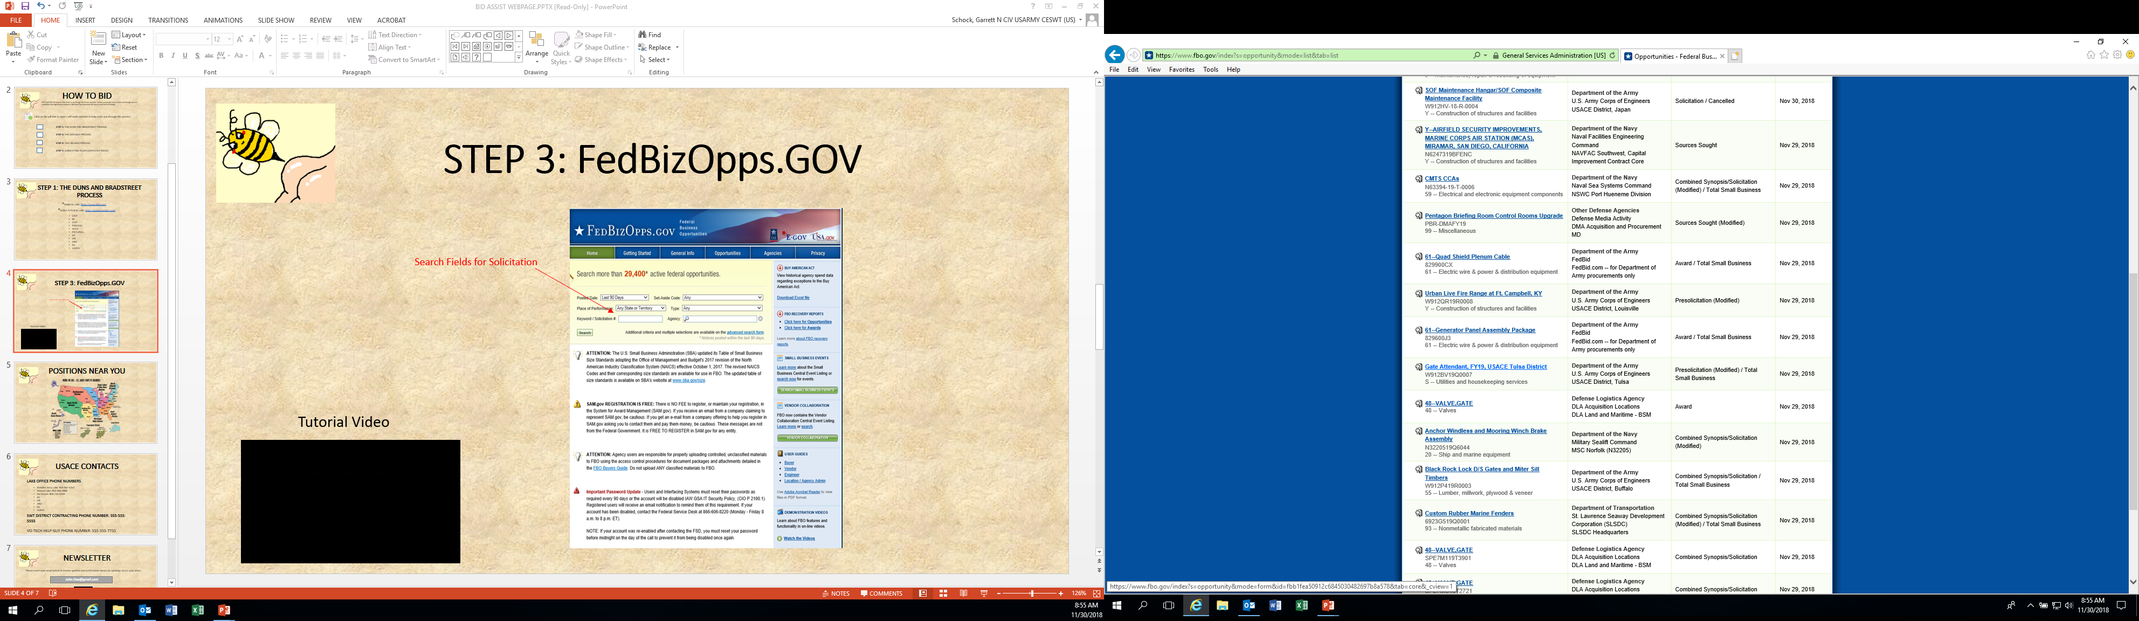
STEP 3: FedBizOpps (FBO.GOV)
Search Fields for Solicitation
Click on Link: www.FBO.gov
You can search several different fields to find the solicitations you want.
Location
Solicitation #
Job Type
Once you click on a job there will be attachments in the solicitation further explaining how to submit a bid to that agency.
Solicitation
Solicitation Results

Slide 7
STEP 4: SUBMITTING YOUR QUOTE
Read the entire solicitation.
Be certain you have an email address
Be certain you acquired your DUNS number from Duns and Bradstreet.
Be certain you acquired your CAGE number from SAMS.gov.
Return only the following:
A completed 1st page of the solicitation including Block 17a with your name, address, email, and DUNS/Cage code numbers, and Blocks 30a., 30b., and 30c.
The Completed Offeror’s Information Sheet
The Pricing Schedule for each area.
No cross outs or strike through marks. Submit a legible quote with no correction marks or your quote will not be considered.
Any amendments to the contract that are issued must be submitted immediately.
Be sure to submit your quote before the deadline.
Email is the preferred method of submission but you may mail, fax, or hand deliver your quote with the following information (Names and Solicitation numbers are subject to change):
If mailing or hand delivering do not staple your documents, paper clip is recommended. If emailing your quote it must be able to read by either Adobe or Microsoft Office.

Slide 8
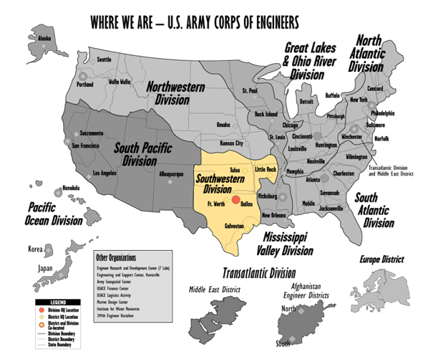
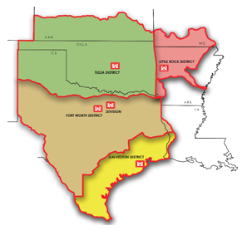
USACE Contacts and Advertisements By Location

Slide 9


Tulsa District Lake Information
Kansas
Tenkiller Lake Project Office
U.S. Army Corps of Engineers
446977 E 980 Road
Gore, OK 74435
Phone: 918-487-5252
Oklahoma
Tenkiller Lake
After selection the lake information will populate.
Texas
Lake Website:
https://www.swt.usace.army.mil/Locations/Tulsa-District-Lakes/Oklahoma/Tenkiller-Lake/
Extra Assistance with the Bidding Process:
KIAMICHI VO-TECH REPRESENTATIVE (For Questions and Technical Assistance):
Ron DeGiacomo: 918-424-8530 (Oklahoma Southeast Area)
John Doe: 918-424-**** (Oklahoma Northeast Area)
TULSA DISTRICT CONTRACTING OFFICE:
US ARMY CORPS OF ENGINEERS
ATTN: CONTRACTING DIVISION, 9TH FLOOR
1645 SOUTH 101st EAST AVE
TULSA, OK 74128
918 669-7352
Click Here For Current Advertisements

Slide 10
Email notifications for updates to website and new contract advertisements.
USACE BID ASSIST
Please insert your email below to receive updates and notifications about job openings across your areas.
John.Doe@gmail.com
Note:
Unsubscribe button at bottom of automated emails.
SUBMIT

Slide 11
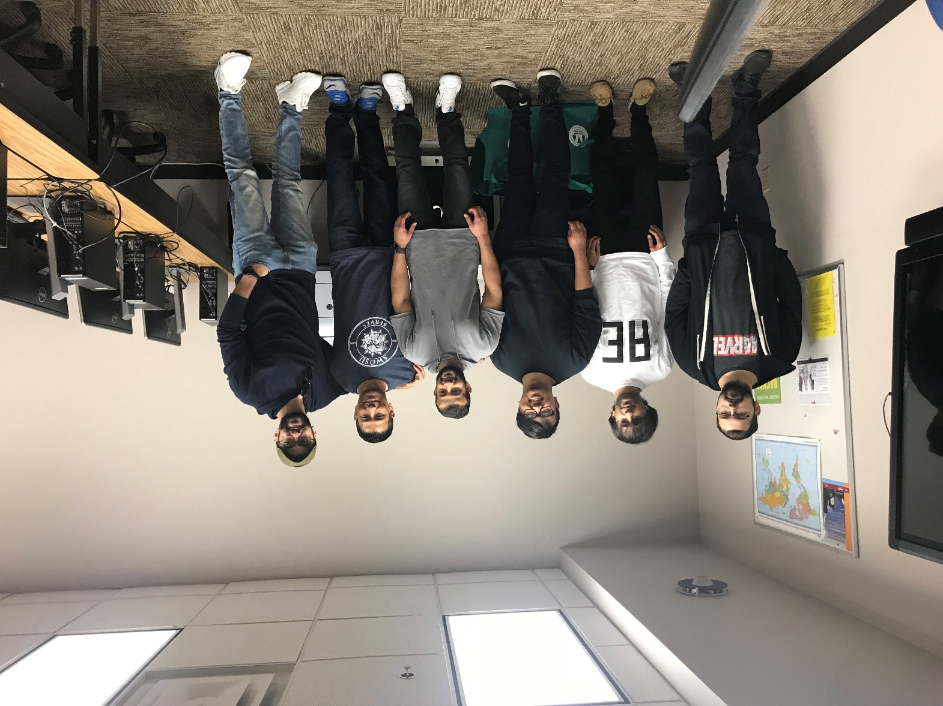
Spring 2019 – Capstone Class
USACE Bid Assist Development:
6 Students Worked:
1,032 hours x Volunteer Wage Rate $25.43/hour (not IT Wage Rate) = $26,243.76
If using IT Hourly Wage Nations:
Average of $28.00/hour = $28,896.00 Value
Students:
- Aashish Gurung (Team Lead)
- Indop Pun Magar
- Hassan Altajer
- Sebastian Skaats
- Hussain Bukhader
- Mahdi Bukhader

Slide 12
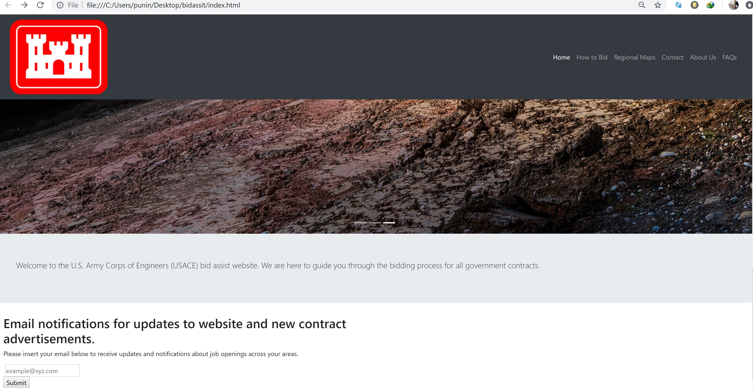

Slide 13


Slide 14
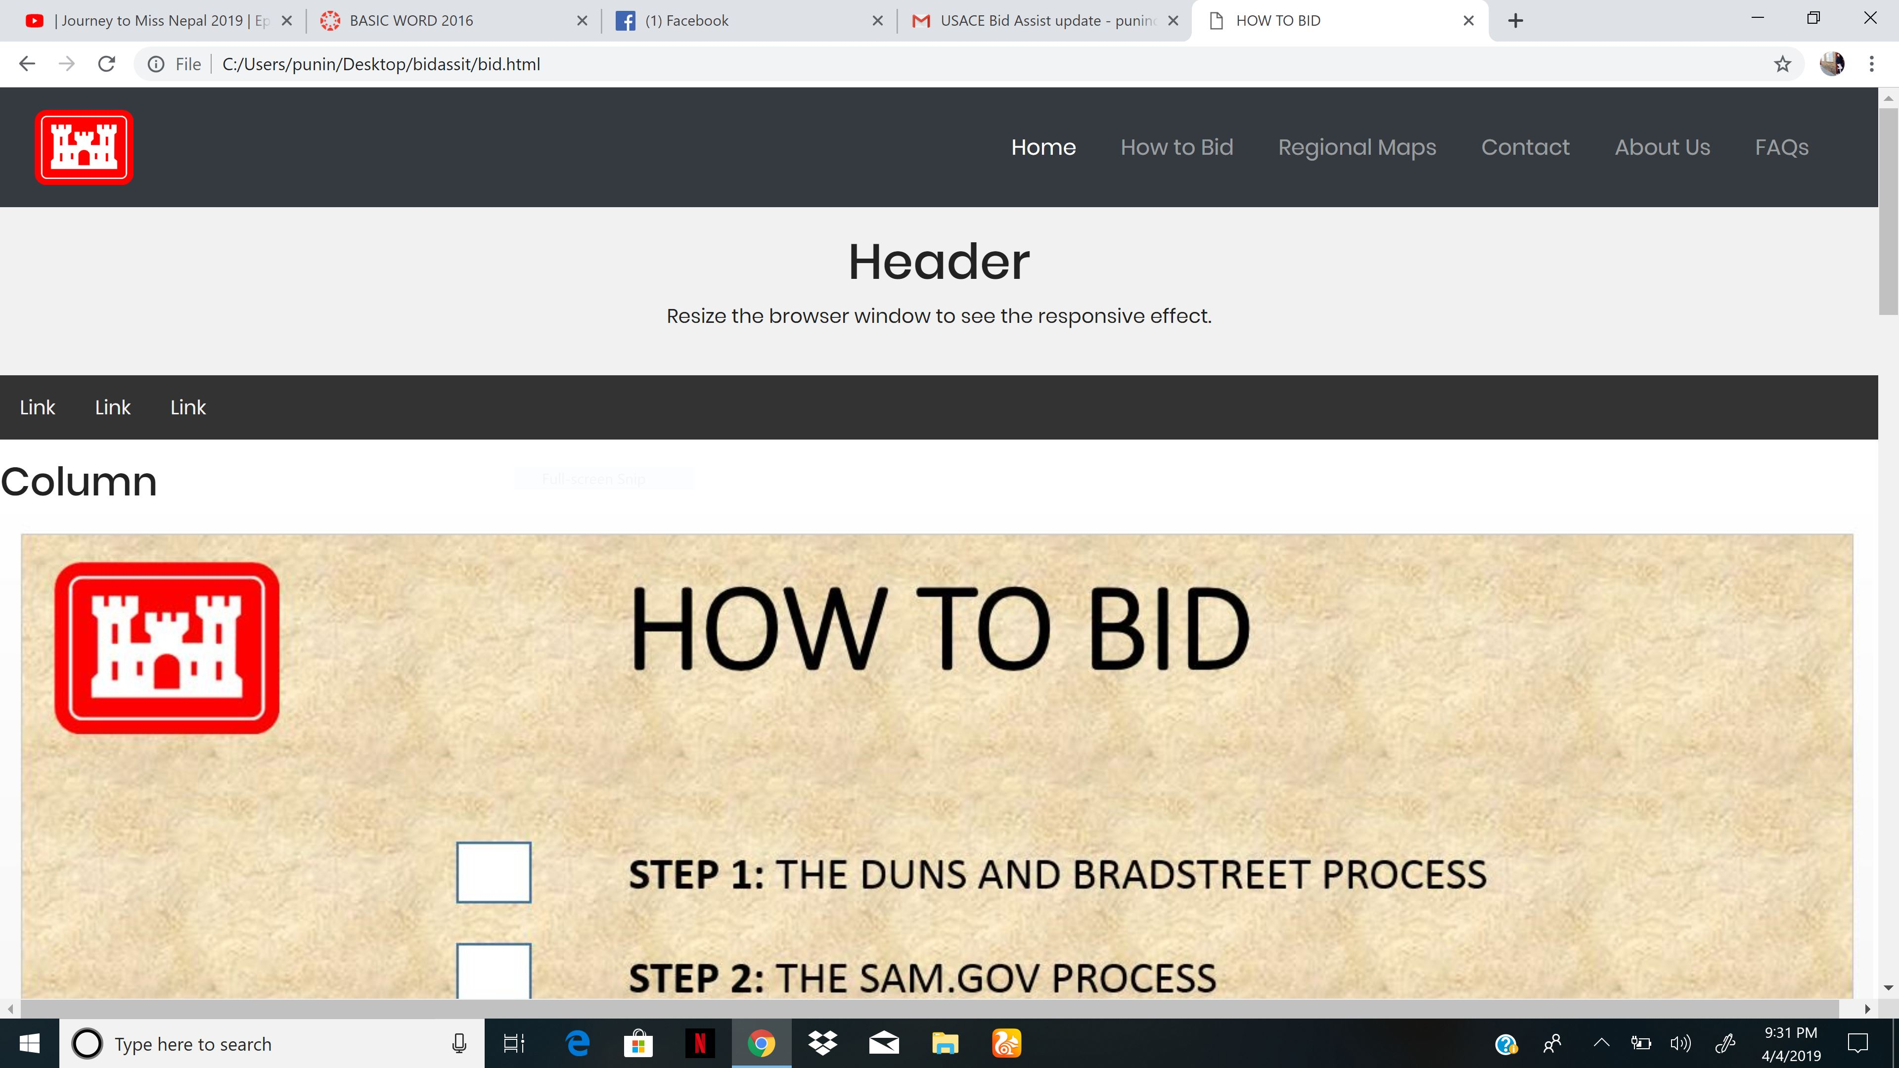

Slide 15
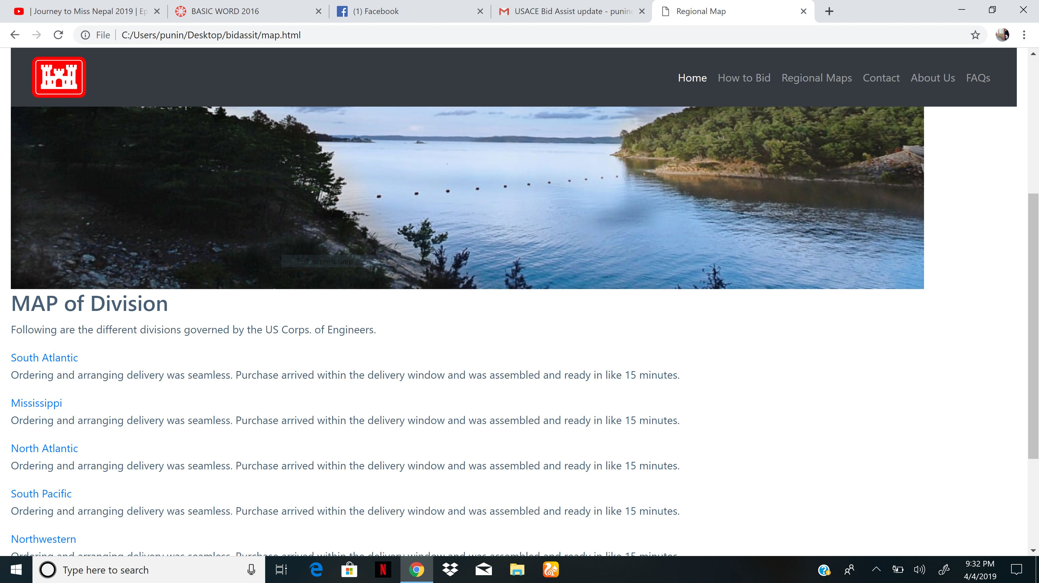

Slide 16
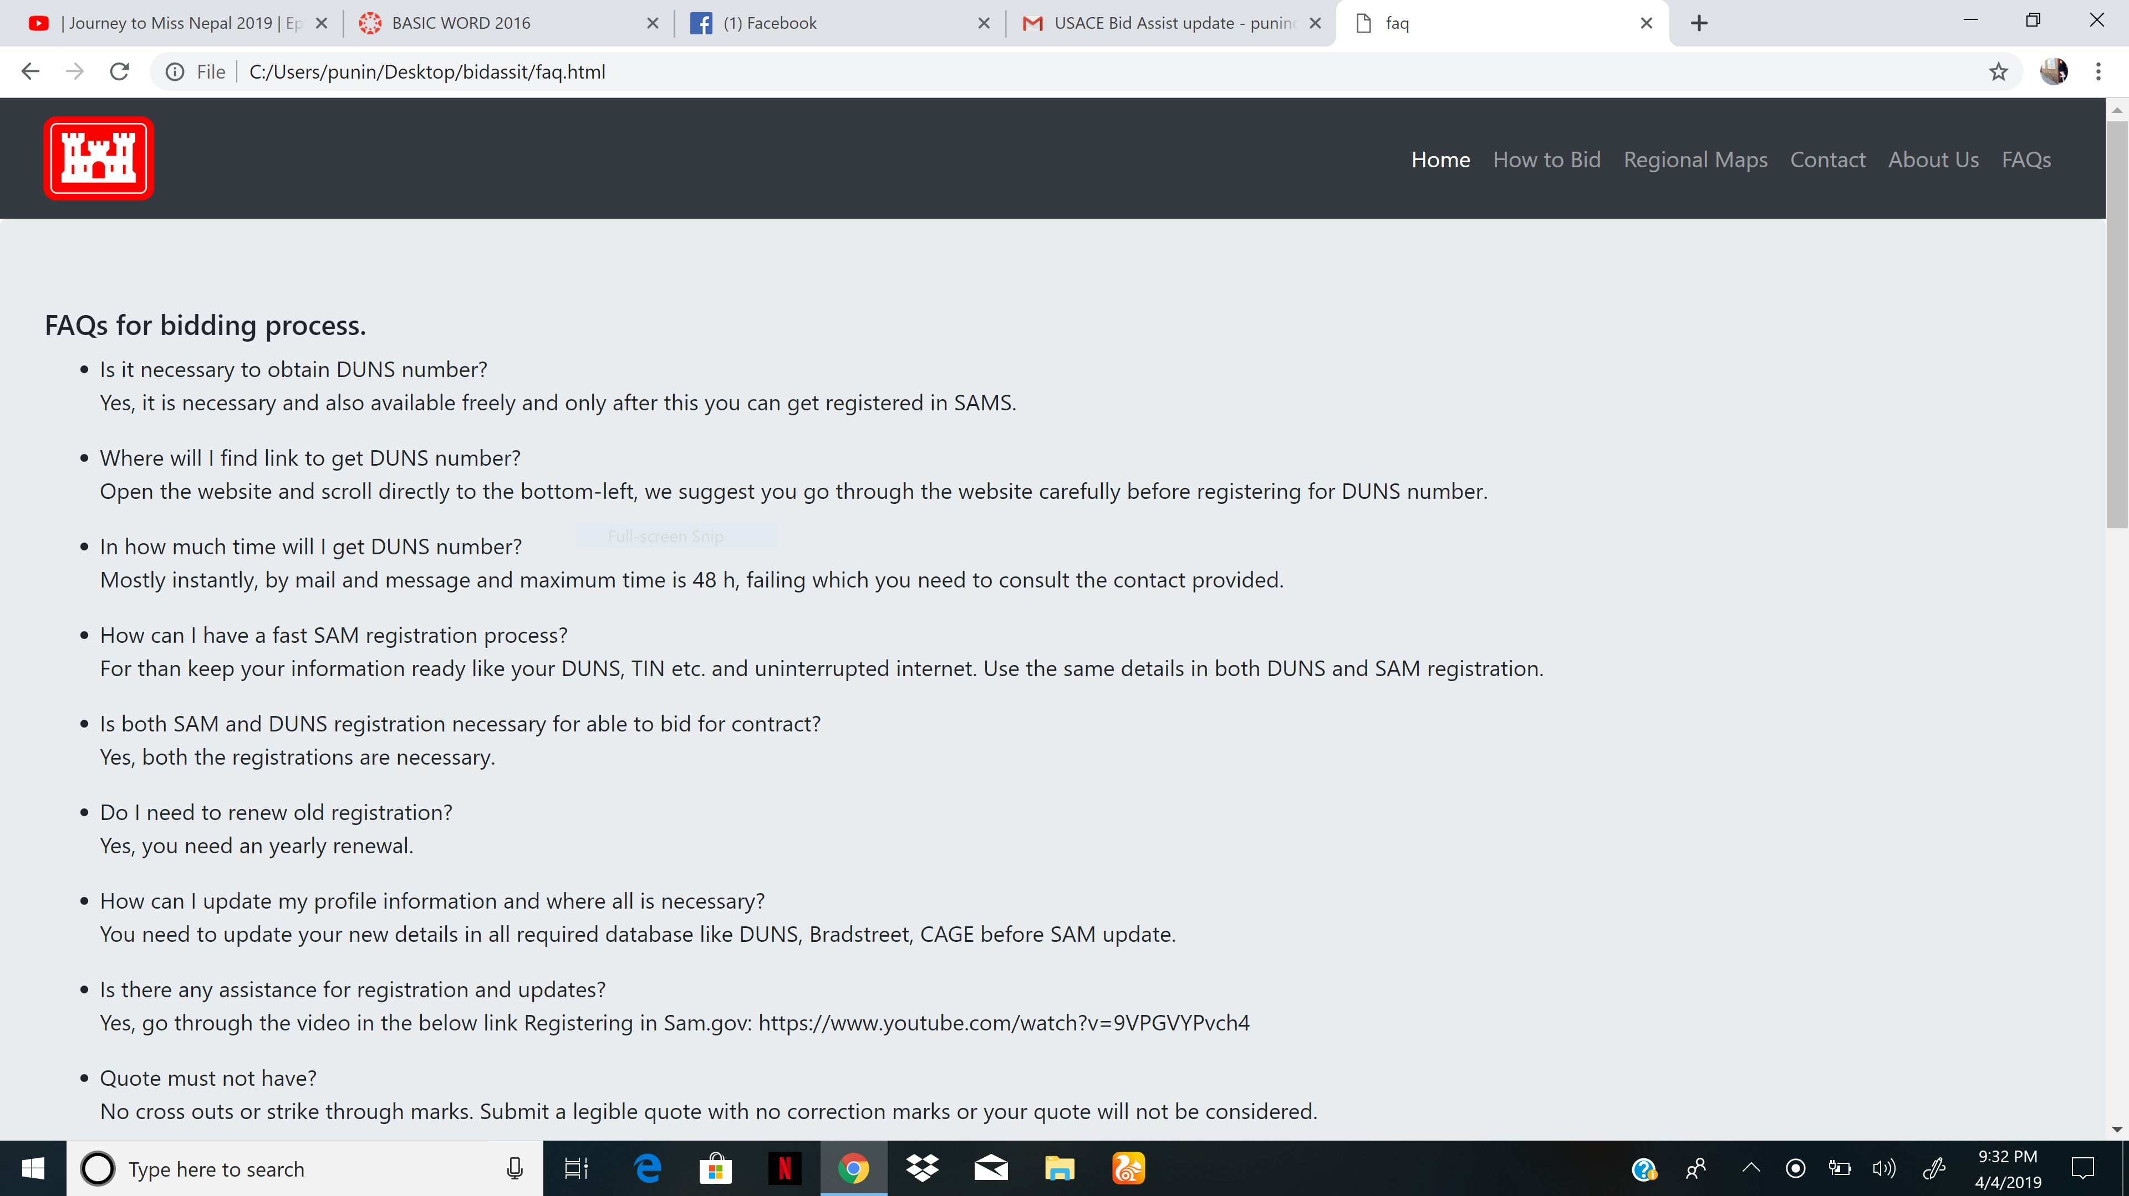

Slide 17
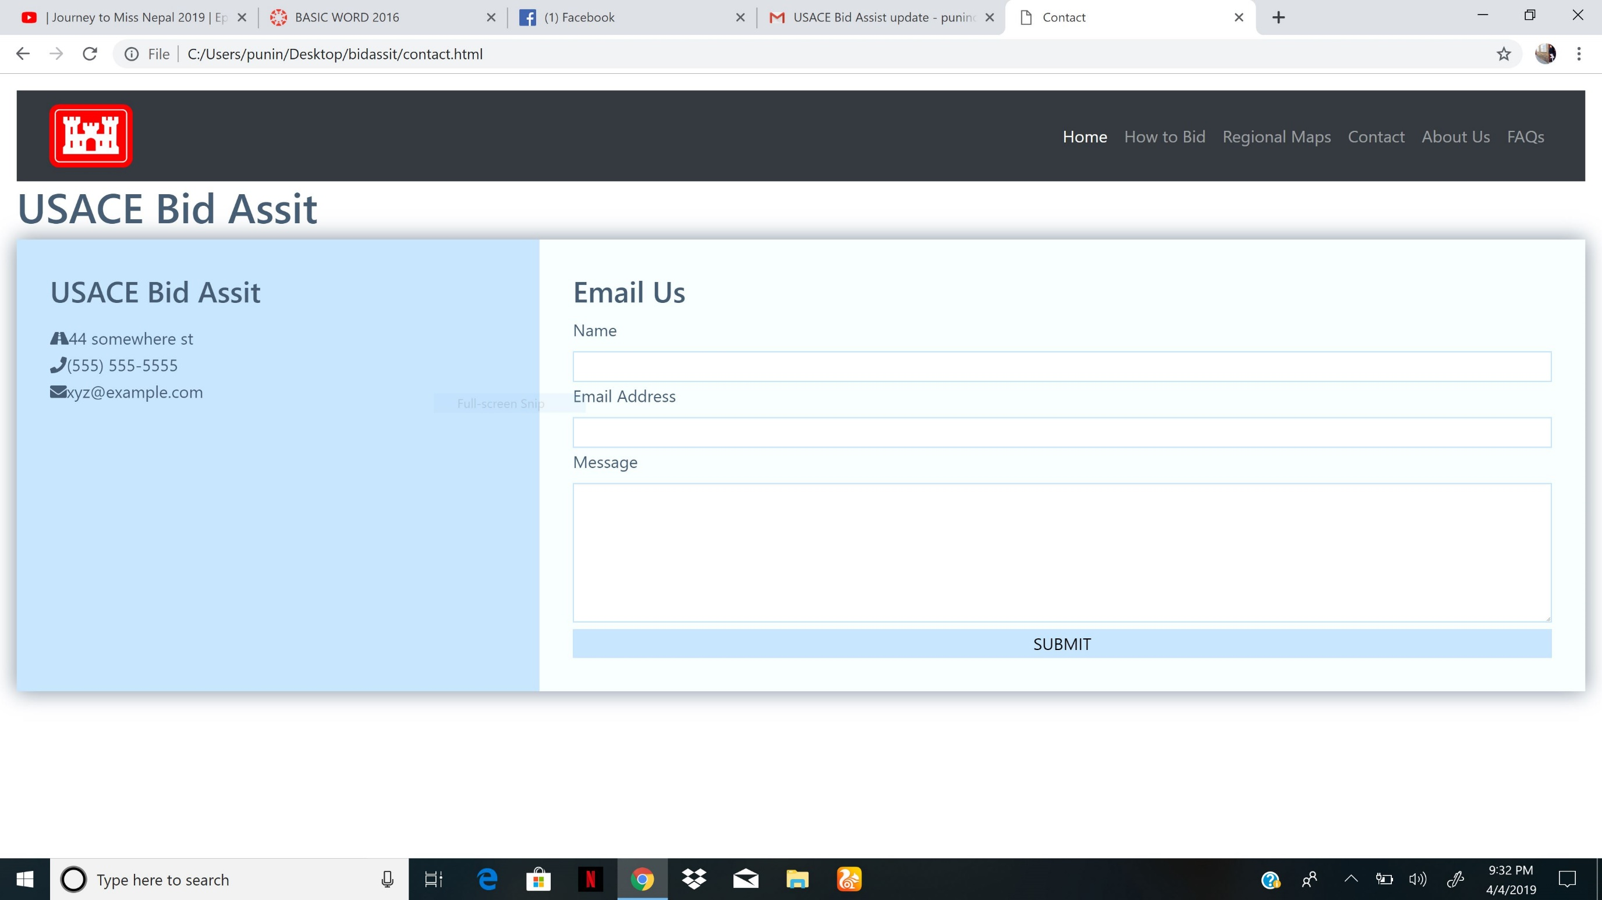

Slide 18

Contact Information:
Sarah Noel
Natural Resources Specialist
Texoma Lake Office
351 Corps Rd.
Denison, TX 75020
Cell: 580-916-5771
Work: 903-465-4990 Ext: 7807
Email: Sarah.K.Noel@usace.army.mil
Discord ID: ROM007 (#3694)
BID ASSIST

